Slide 1
STUDENT MANAGEMENT SYSTEM
STUDENT PORTAL

Slide 2
OVERVIEW
The system involves student booking, payment of fee, accessing of fee statement, posting new exam time table manipulated by the admin.
The system allows the student to send complains to the staff in case of trouble accessing the portal.
This system works dynamically as all information displayed on the system, are widely generated from the database.
We used Xampp as our local host for the project.

Slide 3
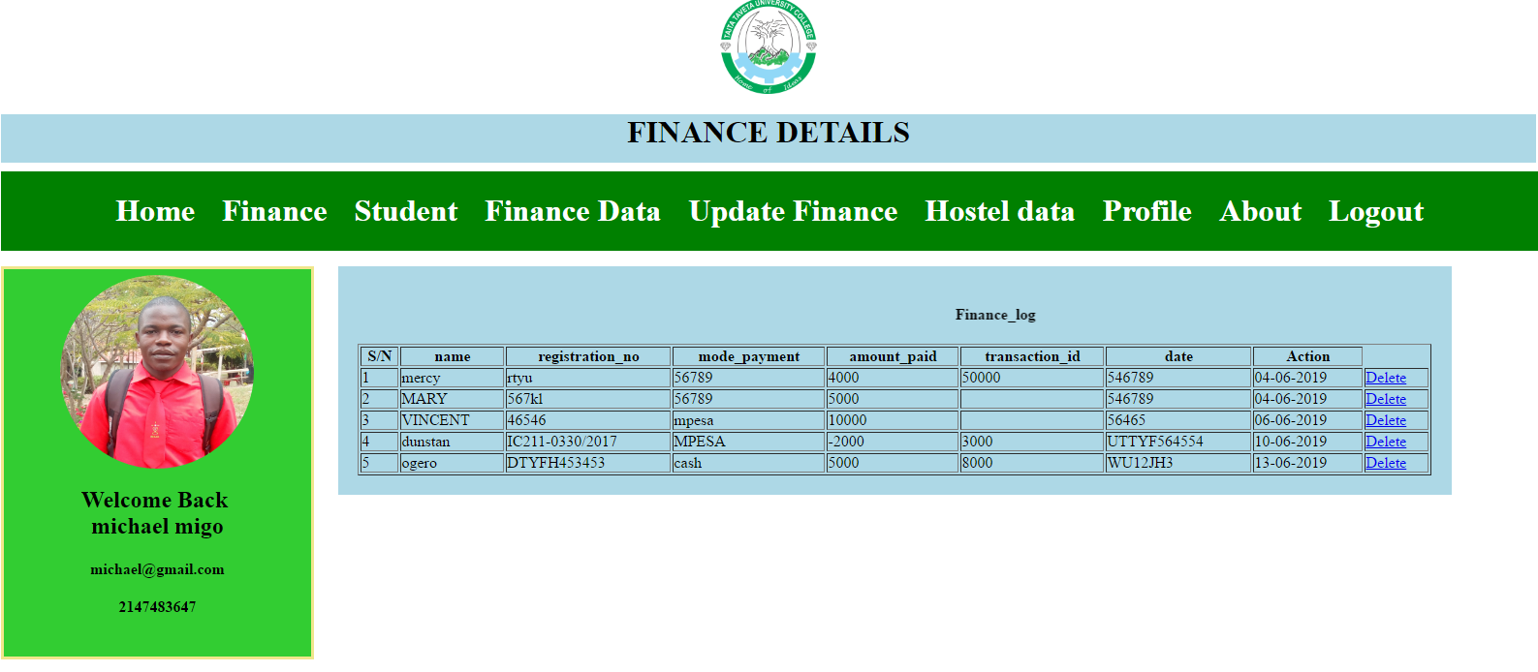

Slide 4
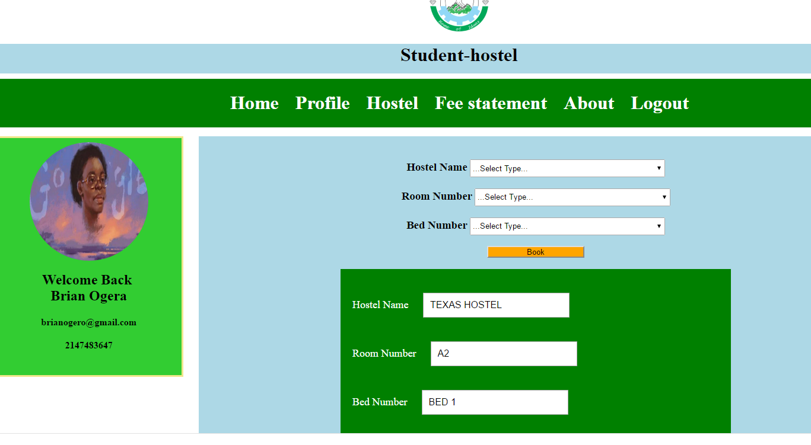

Slide 5
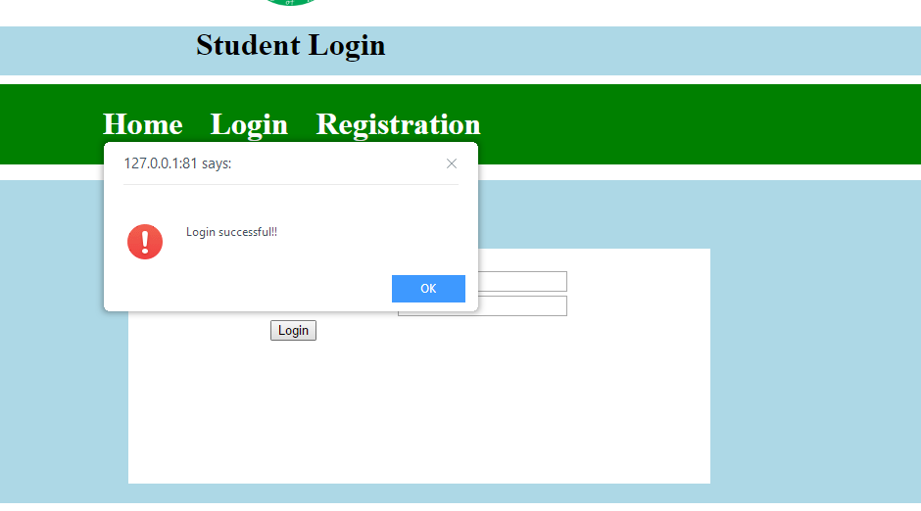

Slide 6
THANK YOU

